Slide 1
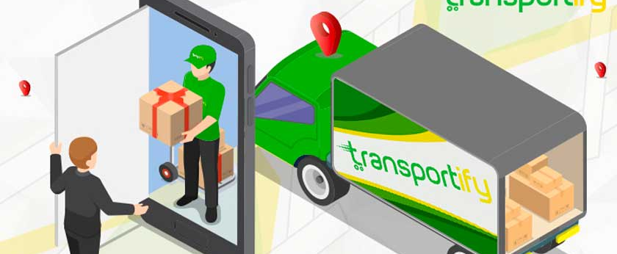
Anna- Santript

Slide 2
Problem Statement
Due to the pandemic situation : It is very important to practice Social Distancing as well as provide the Food Security to the citizens.
Waiting for the ration in Long queues.
Numerous malpractices makes food essentials issued by govt.in Inaccessible and un-affordable to many poor thus resulting in their Food Insecurity
“According to study in March 2008, only 42% of grains reach to target group”

Slide 3
How this can help?
At Doorstep
Hassle free distribution
No waiting in queues
Social distancing
Illegal diversions of commodities, Holding and Black Marketing

Slide 4
The Idea
Ration to be delivered at Doorstep to avoid the long queues which can be the issue of Social Distancing.
Consumer can send Delivery confirmation( Sending SMS to XXXXXX ).
False and Duplicate Entry can be eradicated.
Efficient Transparent Delivery can be achieved.
Useful for “One Nation One Ration Card” Scheme.

Slide 5
Roadmap
Presently ,application is meant for 1 state.
In the upcoming years, Application expands for all the Indian states.
Coverage for each and every individual citizen.
Beneficial for : “One Nation One Ration” Card Scheme.
Monitoring the Issue of Ration Card.

